Slide 1








CAPSTONE PROJECT
Electrification Dynamics: Assessing Growth Patterns and Economic Impacts in Low-Income Countries, Benchmarking against Developed Nations
Presented by: argocd team

Slide 2




Our Team
Chukwu Chukwuemeka Jude - Project Lead
Caleb Balogun - Assitant Team Lead
Owolabi Abdulquawiyy Adisa - Query Analyst
Linda Iwiyisi Owolabi
Kanda Sam k
Olufemi Sobiye
Kanyinsola Diyan
Priscila Waihiga Kamiri
Seyi Balogun
Omolala Esther
Tomiwa Atobilye - Sefeoluwa Ayeni - Echezonachukwu Enemuo - Ismail Bashiru
Ogooluwa Olaniran

Slide 3




Presentation Outline
Problem Statement
Project Aim and Synopsis
Introduction
Dataset Description and EDA
Data Preparation
Model Development
Model Deployment and Demo

Slide 4
Problem Statement
In low-income countries the electrification landscape plays a crucial role in shaping socio-economic development. While various projects have previously focused on mapping areas with poor electrification and implementing strategies for improvement, a significant research gap remains unexplored.
Our approach involves classifying countries based on their electrification status, exploring correlations between electrification rates and key economic indicators, and predicting the growing economic gap between developing (African) and developed countries. By addressing the critiques of previous research, we plan to enhance the methodologies, utilizing ARIMA and LSTM models for predictive analysis.

Slide 5








Project Aim
Develop a machine learning model to estimate the future economic inequality between developing (African) and developed countries based on their level of electrification

Slide 6
Introduction
The problem lies in the insufficient understanding of the economic repercussions of electrification growth in low-income countries.
This lack of predictive insights hampers the ability to formulate targeted electrification programs and optimize resources for economic benefits.
Our project builds on the work of previous teams by focusing on the economic implications of electrification. While previous teams (Team Django, and Team GCP) have mapped areas with poor electrification and explored strategies for improvement, our project takes a step further by examining the economic impact of these improvements.
Our project seeks to rectify this by developing robust machine learning models and providing actionable recommendations for sustainable development in low-income countries while drawing insights from benchmarking against developed nations.
Our research will enhance the methodologies used in previous projects by incorporating machine learning techniques to predict future economic disparities based on electrification levels.

Slide 7


Project Objectives
1.
Classify countries based on their electrification status using supervised learning algorithms.
2.
Explore correlations between electrification rates and key economic indicators such as Population, GDP, Unemployment rate, etc.
3.
Predict how the economic gap between countries (an African vs a developed country) will grow based on level of electrification.

Slide 8

PROCESS FLOW
Preparing the Dataset
Feature Selection & Engineering
Data Cleaning
Model Training and Evaluation
Exploratory Data Analysis

Slide 9



Dataset Description
The given dataset is a CSV file.
Imported the dataset through the pd.read_csv function.
We started with installing and importing libraries required for the project, as given below
-Data Manipulation Libraries – Pandas and Numpy.
-Data Visualization Libraries – Seaborn, matplotlib.pyplot, plotly.express.

Slide 10

Exploratory Data Analysis
(EDA) was done as given below.
- The shape of the Dataset is understood as 946 rows and 8 columns.
- The info on columns of the dataset was obtained through df.info().
- The dataset was checked for the presence of any missing values – there were no missing values.
- The dataset was checked for the presence of any duplicate values – there were no duplicate values.
- The basic statistics of the dataset were checked – mean, standard deviation, min, and max values of each column were checked using df. describe().T

Slide 11
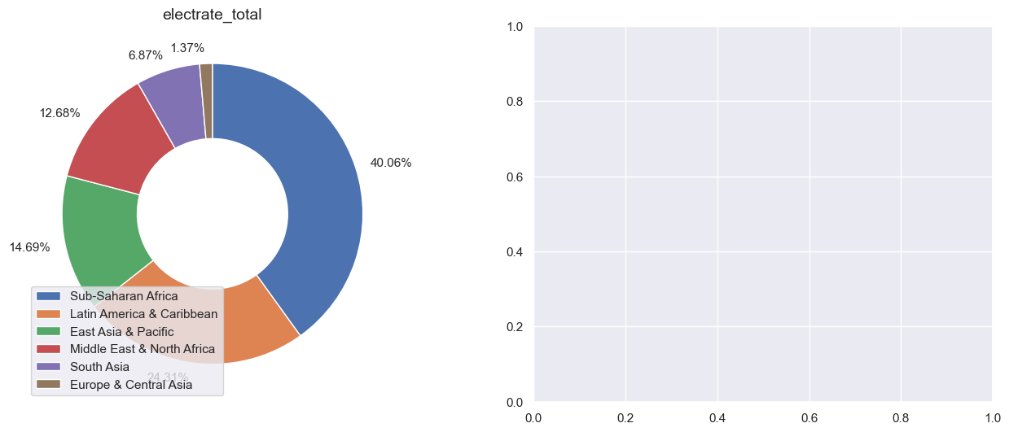
Dataset Description
fig 1
The Pie Chart gives us an insight into which region has the highest electricity rate. It has been uncovered that the highest total electricity rate was recorded in the Sub-Saharan Africa Region and the lowest rates were recorded in the Europe and Central Asia Region.

Slide 12
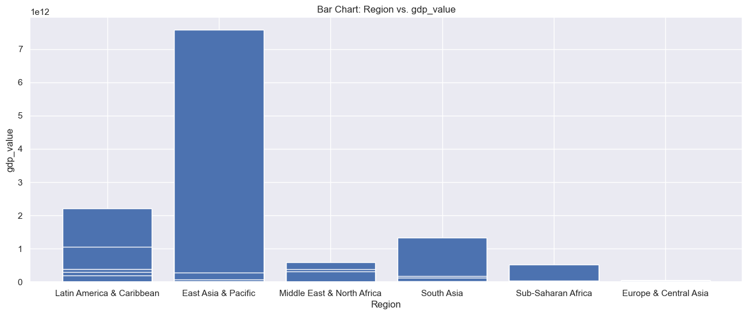
Region wise GDP
fig 2
From this Bar Chart, it is evident that the Region with the highest GDP value is the East Asia and Pacific Region. Sub-Saharan Africa has a very low GDP rate.

Slide 13
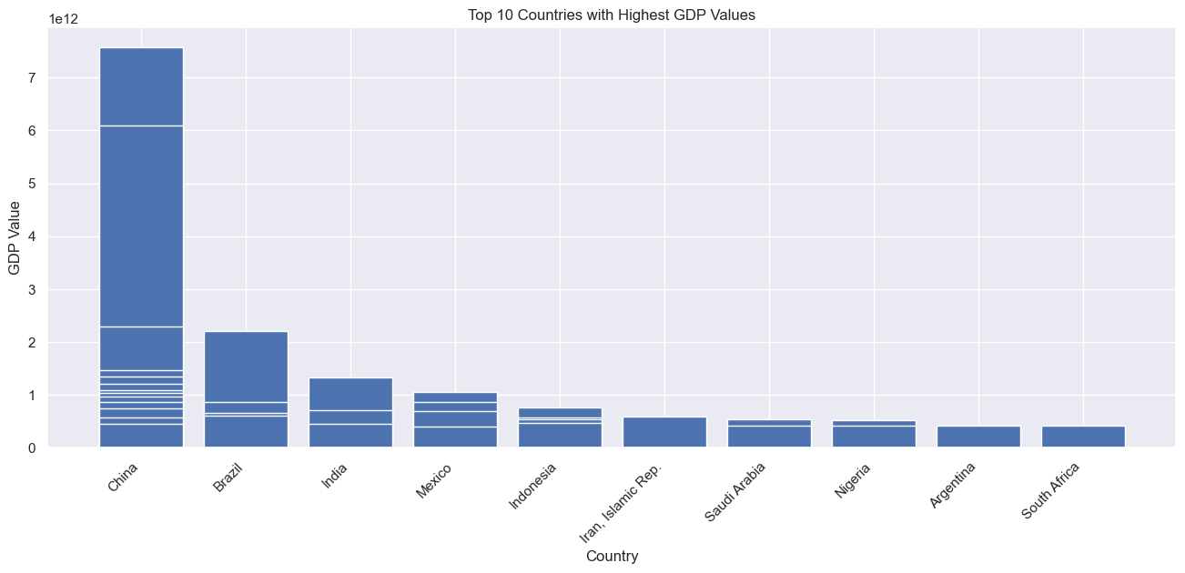
Top Ten Countries with high GDP
fig 3
This Chart gives us the top 10 countries with the highest GDP values, Not surprising that China takes a massive lead, followed by Brazil. The least of this top 10 list is South Africa.

Slide 14
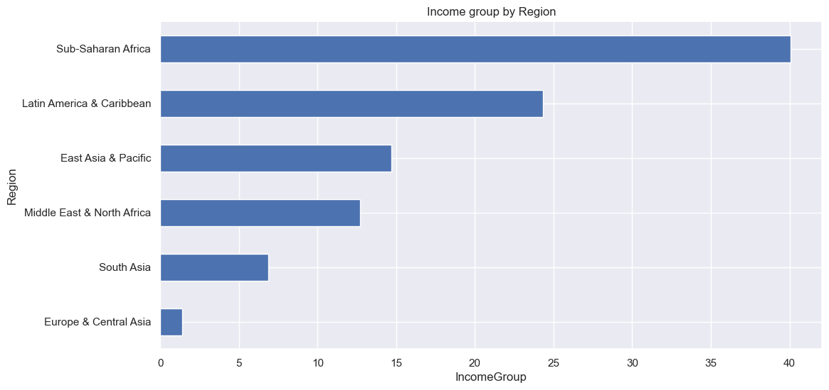
Region-wise Income
fig 4
From the Bar Chart above, it is evident that Sub-Saharan Africa is the Region with the highest income group.

Slide 15
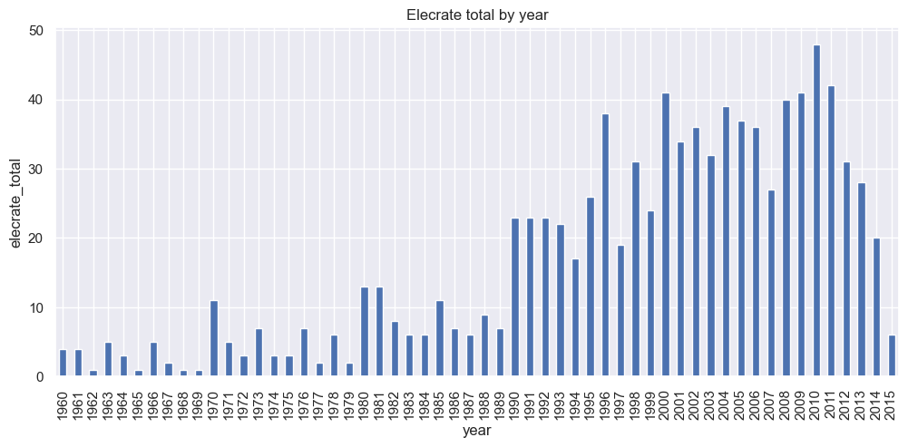
Highest Recorded Electrification Rate
fig 5
This bar chart gives us an insight as to what year has the highest recorded total electricity rate. It has therefore been discovered that the highest total electricity rate was recorded in 2010 closely followed by 2011. The least recorded rates occurred in the 1960's.

Slide 16
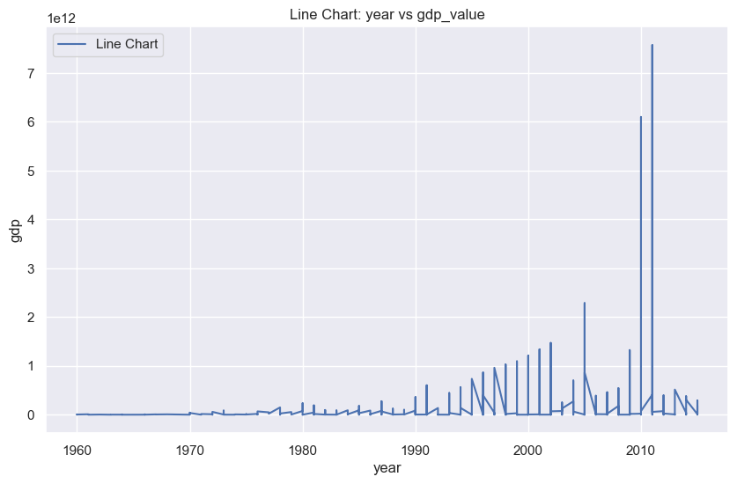
GDP growth across Regions
fig 6
This line chart gives us a vivid visuals to discover what year had the highest record of GDP value across all regions, 2011 clearly takes the spotlight followed by 2010.

Slide 17
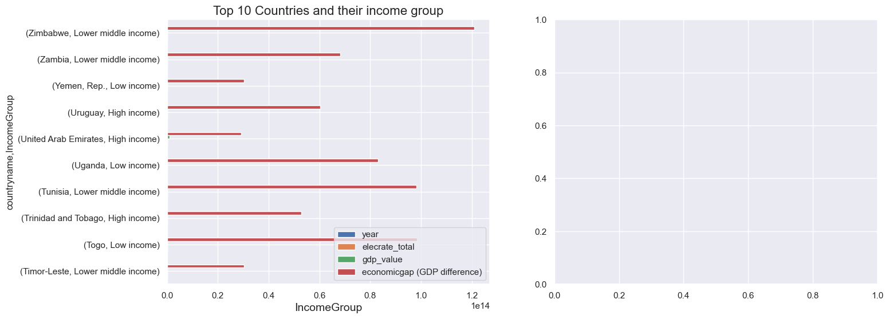
Country-wise Income Group
fig 7
Here we can see from this chart the uncovering of the top 10 countries based on their income rate and group. Zimbabwe has the highest group of Lower middle income earners

Slide 18
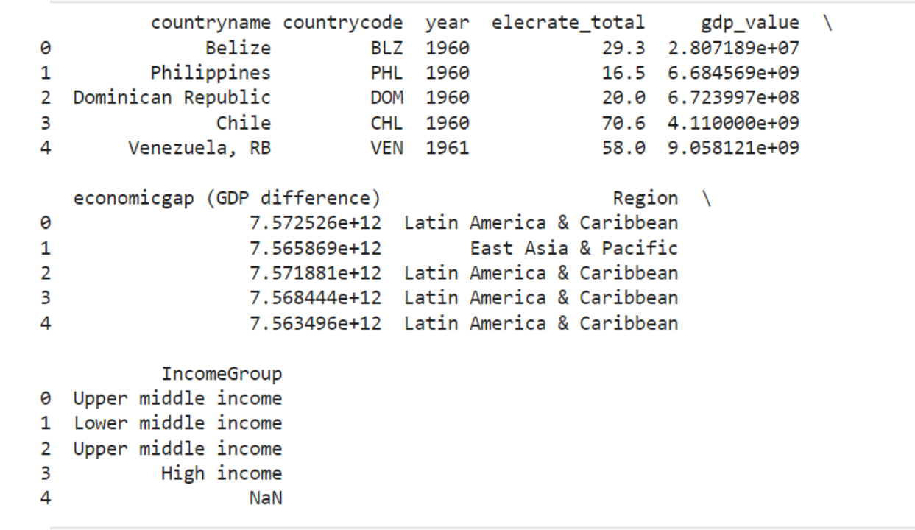
Data Preparation
Different Datasets of Electrification rate, GDP Value, Region-wise segregation, and Income Group were combined and collated as a Single Dataset for the Model.

Slide 19
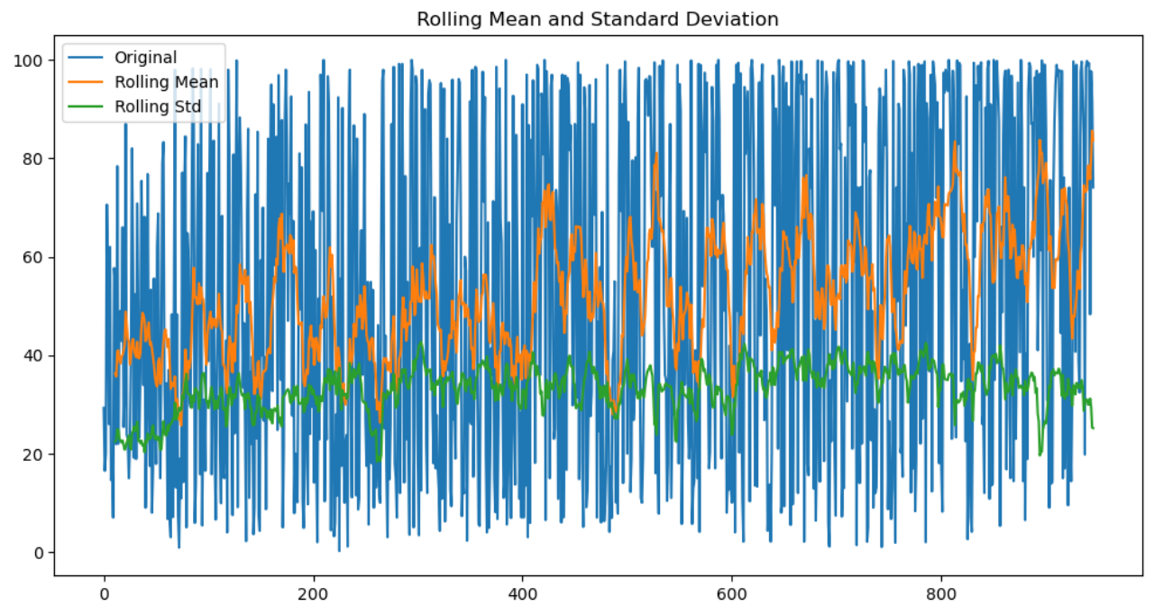
Model Development
Time Series Analysis ARIMA Model
Stationarity

Slide 20
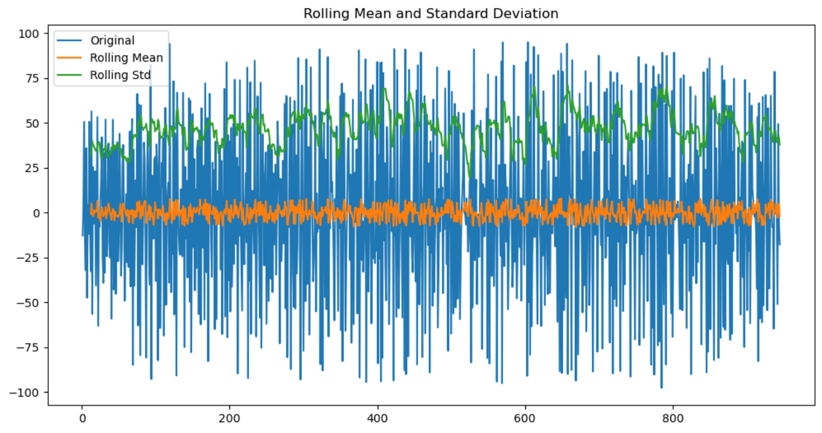
Time Series Analysis ARIMA Model
Stationarity After Differencing

Slide 21
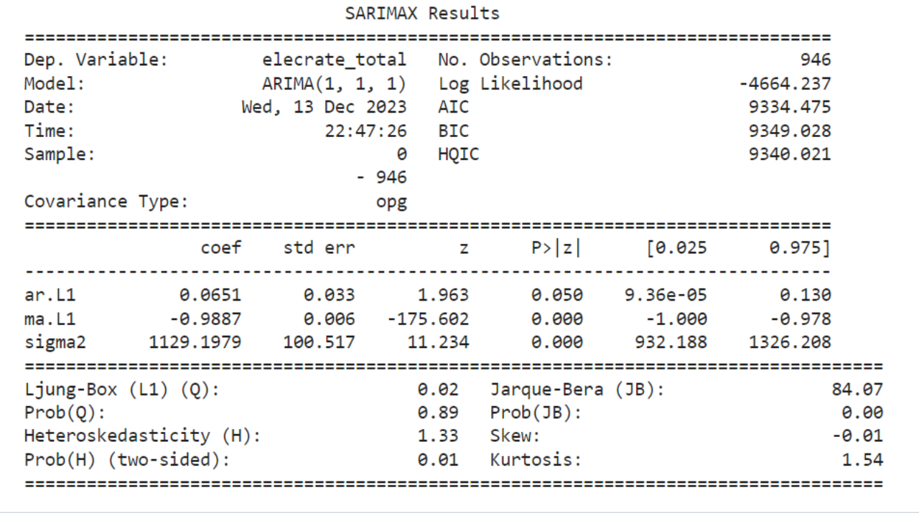
Time Series Analysis ARIMA Model
Model Results

Slide 22
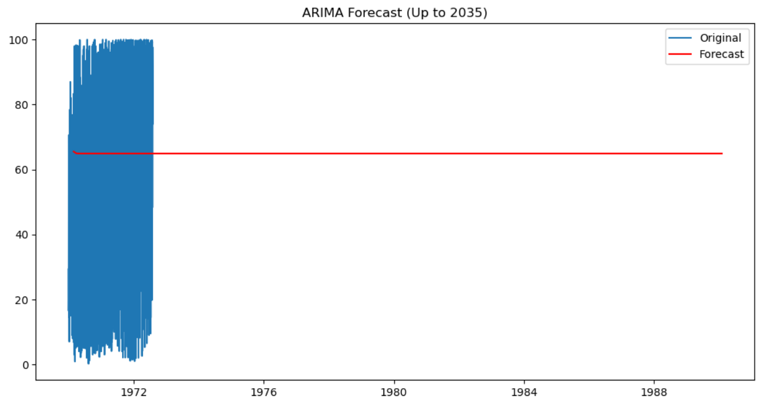
Time Series Analysis ARIMA Model
Forecasting Results

Slide 23
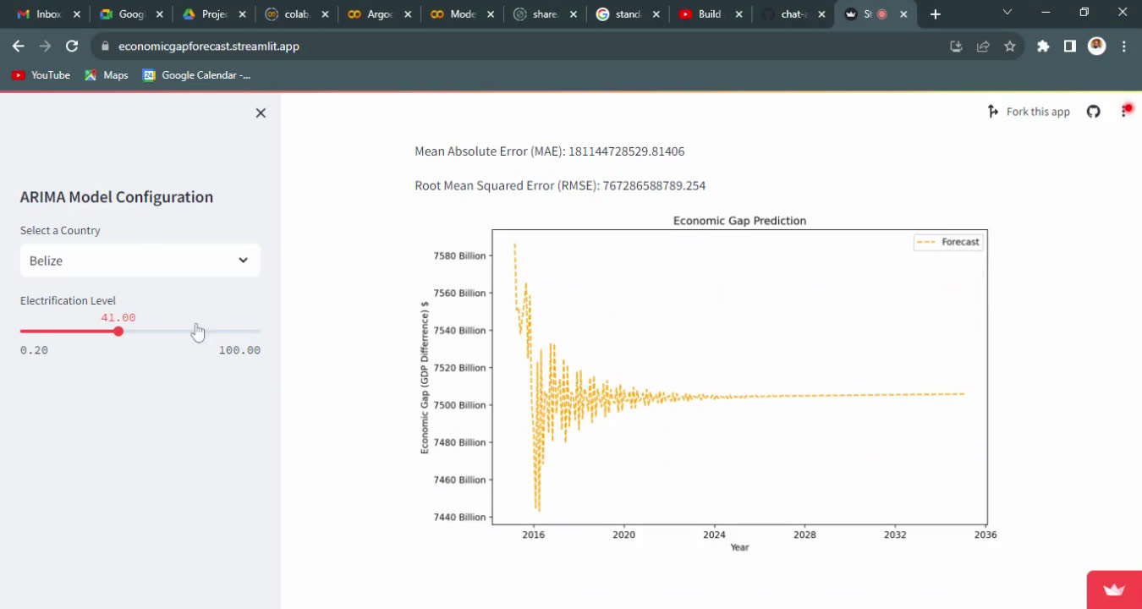
Model Deployment
Demo

Slide 24






